Slide 1

0.3 DSGE模型几种典型构建

Slide 2
Outline
A very simple framework for closed economy
A DSGE model with banking sector
An Open Economy with import and export sector

Slide 3
A Simple Framework for Closed Econ.
Households
Firms
Final goods firm
Immediate goods firm
Governments
Monetary Authority

Slide 4
Model framework in CLM(2010)
This is a standard monetary DSGE model which includes a banking sector and financial markets;
Fit the model to Euro Area and US data;
They found many important results, which including
Financial intermediation turns an otherwise diversifiable source of idiosyncratic economic uncertainty, the ‘risk shock’, into a systemic force.
Notes:
Christiano, L. and R. Motto, et al. (2010). "FINANCIAL FACTORS IN ECONOMIC FLUCTUATIONS." European Central Bank Working Paper Series(No.1192).

Slide 5
Model framework in CLM(2010)

Slide 6
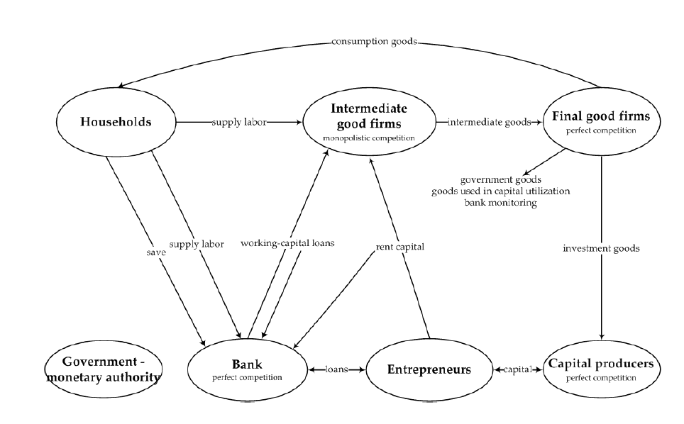

Slide 7
CTW(2011)
The model incorporate financing frictions for capital, employment frictions for labor and extend the model into a small open economy setting.
Main results are that (i) a financial shock is pivotal for explaining fluctuations in investment and GDP. (ii) The marginal efficiency of investment shock has negligible importance. (iii) The labor supply shock is unimportant in explaining GDP and no high frequency wage markup shock is needed.

Slide 8
Basic model framework in CTW(2011)
Notes:
Christiano, L. J. and M. Trabandt, et al. (2011). "Introducing financial frictions and unemployment into a small open economy model." Journal of Economic Dynamics and Control 35 (12): 1999-2041.

Slide 9
Readings
CLM(2010): Christiano, L. and R. Motto, et al. (2010). "FINANCIAL FACTORS IN ECONOMIC FLUCTUATIONS." European Central Bank Working Paper Series(No.1192).
CTW(2011): Christiano, L. J. and M. Trabandt, et al. (2011). "Introducing financial frictions and unemployment into a small open economy model." Journal of Economic Dynamics and Control 35 (12): 1999-2041.

Slide 10
Summary
I. DSGE models can be very simple, and also can be very complicate with hundreds of variables and equations based on the questions in hand.
II. We introduce three simple frameworks which many be useful to help you build your own models.

Slide 11
Thanks！

